Slide 1


JOBIA
FR
Team-6:
Syed Mohtashim Ahsun
Ariba Mehdi
Javeria Alam
Saba Yousuf
FABRIKAM RESIDENCES

Slide 2

Table of Content
Problem Statement
Purpose
Process Model
Salient Features
Product Functions
ERD
UML Diagrams
Technology Stack
Business Model

Slide 3

INTRODUCTION

Slide 4
PROBLEM STATEMENT
With the growing world, it has become difficult for people to find their desired job.
Also, choosing the right fit from the market according to the job description is a challenging task to perform.

Slide 5

PURPOSE
Help candidates to find relevant job
To minimize the stress of applying for jobs in multiple companies
Follow the tagline “Upload, sit back and relax”
Find the best fit from the market according to the job description

Slide 6
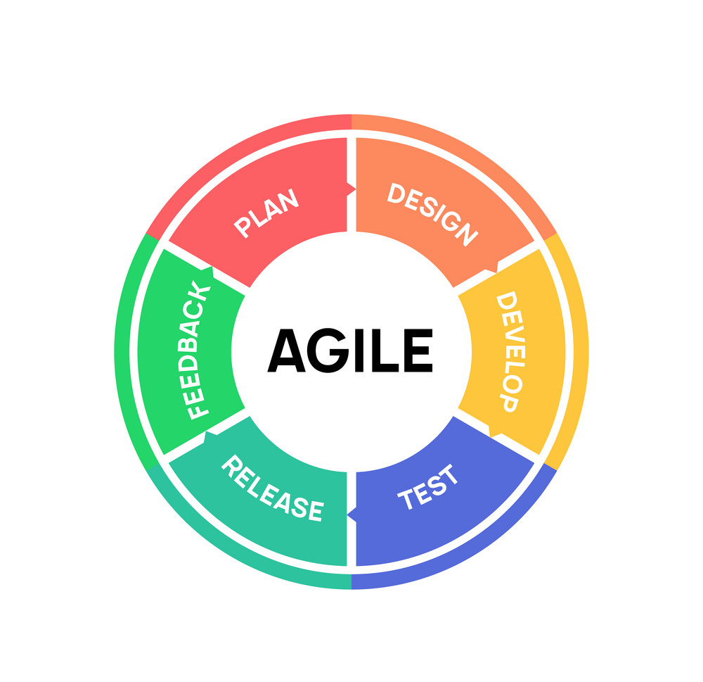
PROCESS MODEL
For this we are employing agile methodology:
Teams can quickly adapt to requirements changes without deadlines
Agile helps reduce technical debt
Improves customer satisfaction
Delivers a higher quality product

Slide 7

DESCRIPTION

Slide 8

SALIENT FEATURES
Generate Resume
Job Portal
Forward resume to the suitable Job position
Notify candidate

Slide 9
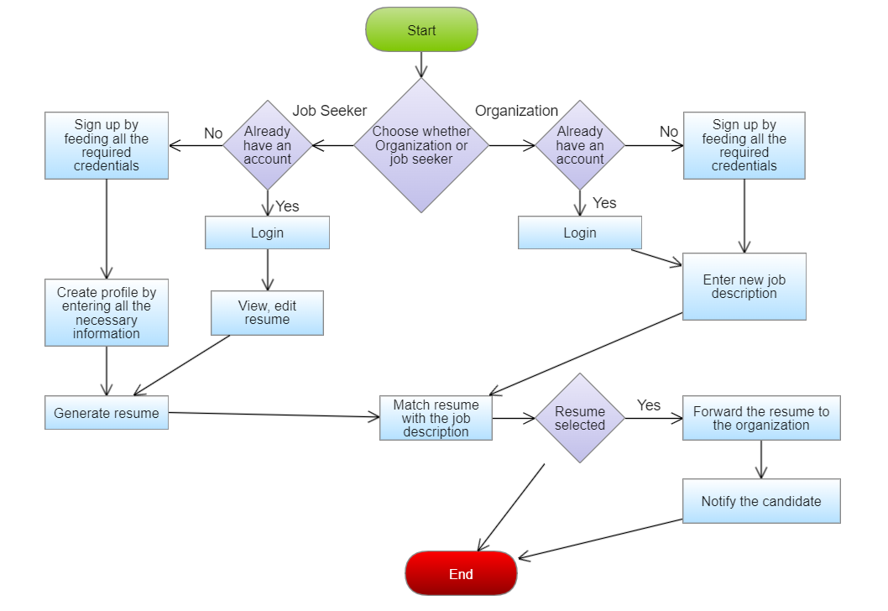
PRODUCT FUNCTIONS

Slide 10
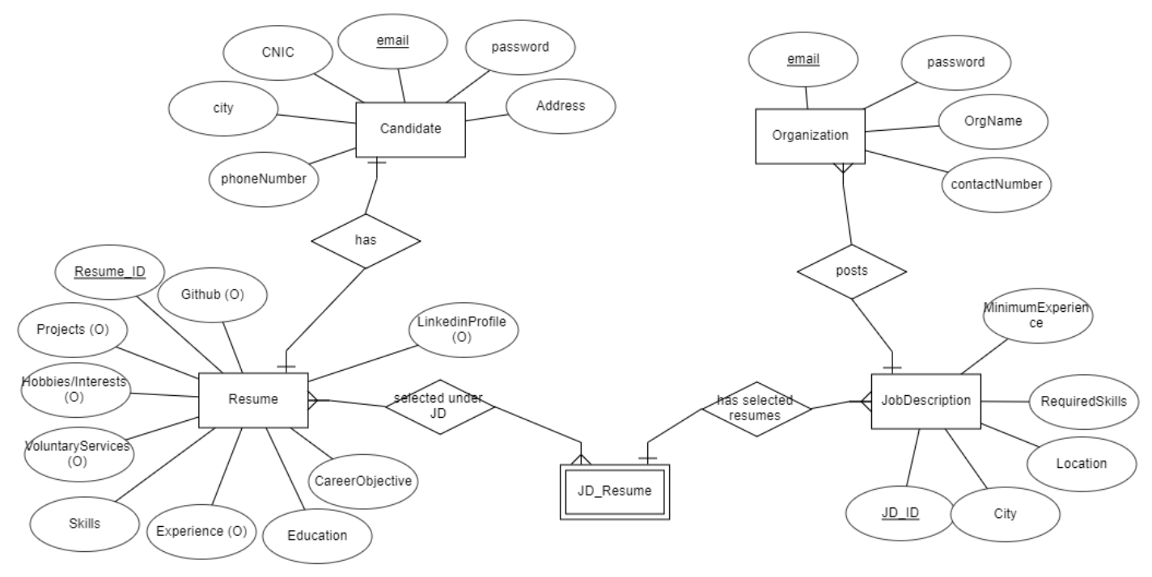
ENTITY RELATIONSHIP DIAGRAM

Slide 11
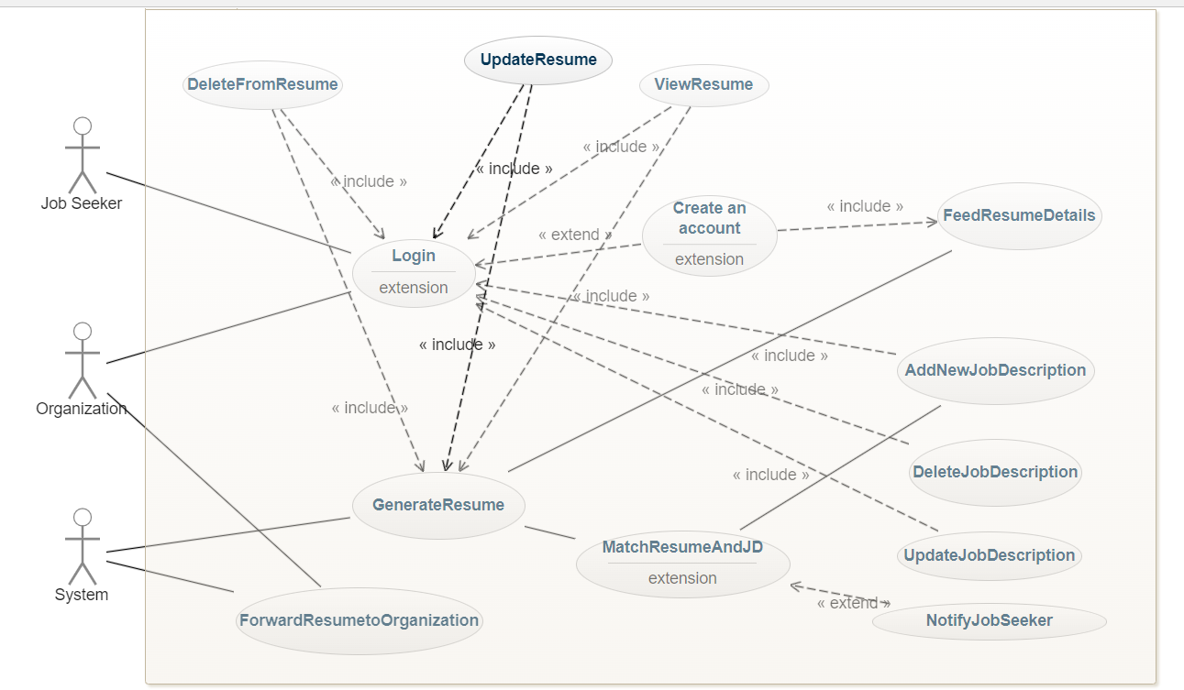
USE CASE DIAGRAM

Slide 12
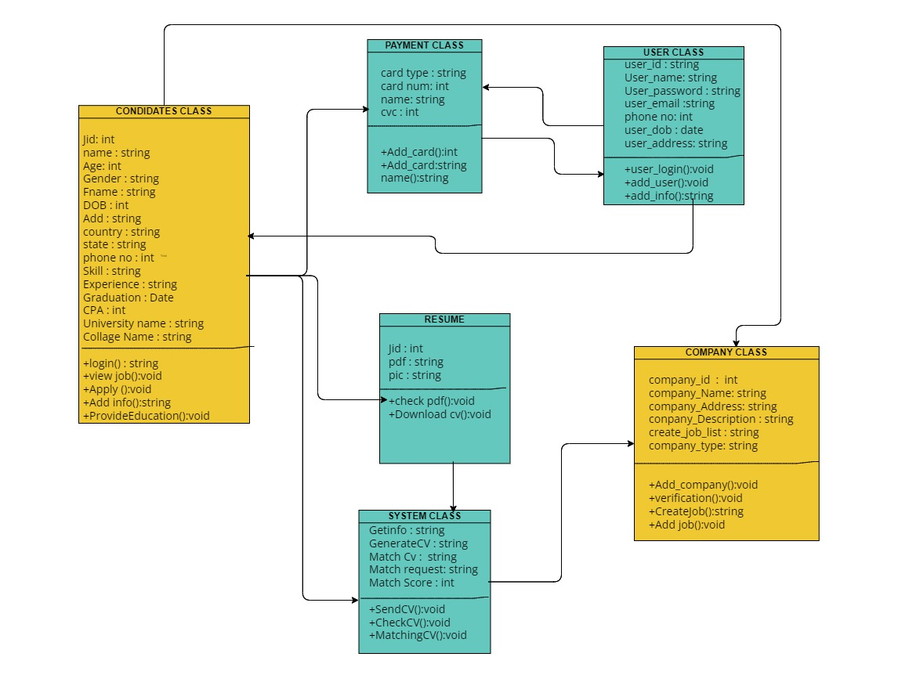
CLASS DIAGRAM

Slide 13
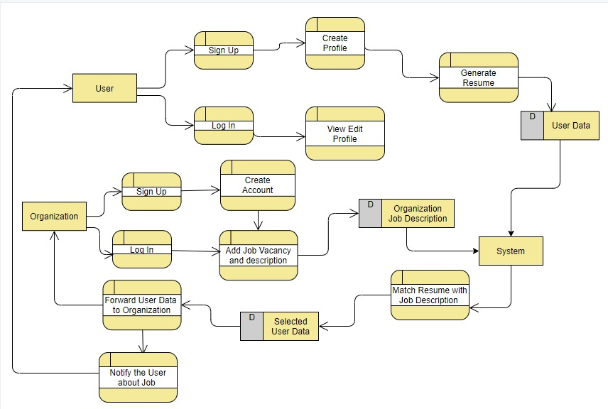
DATA FLOW DIAGRAM

Slide 14





TECHNOLOGY STACK
Development | Database | Work Management Tool | Managed Project
React.js (Front-end) Nest.js (Backend) | MySQL Workbench | Jira | Github

Slide 15

BUSINESS MODEL
After almost an year the webpage will start generating the revenue with respect to the amount of traffic it is generating.
The amount of job seeker and organizations approaching our website for job recruitment, as each account subscription cost

Slide 16
CONCLUSION
Plan boundaries will be adequate to make a completely utilitarian, simple to use and extremely amazing job recruitment website

Slide 17
THANK YOU! ☺

